Slide 1
CAPSTONE PROJECT
FAKE NEWS
Presented By:
1. Student Name- CHEZHIYAN SY
2. College Name- MADHA ENGINEERING COLLEGE
3. Department- CIVIL ENGINEERING

Slide 2
OUTLINE
• INTRODUCTION
• WHAT IS FAKE NEWS..?
• FAKE NEWS CHARACTERIZATION FAKE NEWS DETECTION
• WHAT IS TFIDFVECTORIZER
• EXAMPLE
• CONCLUSION

Slide 3
INTRODUCTION
FAKE NEWS SPREADS LIKE A WILDLIFE AND THIS IS A BIG ISSUE IN THIS ERA.
FOR SOME YEARS, MOSTLY SINCE THE RISE OF SOCIAL MEDIA, FAKE NEWS HAVE BECOME A SOCIETY PROBLEM, IN SOME OCCASION SPREADING MORE AND FASTER THAN THE TRUE INFORMATION, IN THIS PAPER I EVALUATE THE PERFORMANCE OF ATTENTION MECHANISM FOR FAKE NEWS DETECTION ON TWO DATASETS, ONE CONTAINING TRADITIONAL ONLINE NEWS ARTICLES AND THE SECOND ONE NEWS FROM VARIOUS SOURCES.
IT SHOWS THAT ATTENTION MECHANISM DOES NOT WORK AS WELL AS EXPECTED, IN ADDITION, I MADE CHANGES TO ORIGINAL ATTENTION MECHANISM PAPER, BY USING WORD2VEC EMBEDDING, THAT PROVES TO WORKS BETTER ON THIS PARTICULAR

Slide 4
WHAT IS FAKE NEWS..?
A type of yellow journalism, fake news encapsulates pieces of news that may be hoaxes and is generally spread through social media and other online media. This is often done to further or impose certain ideas and is often achieved with political agendas. Such news items may contain false or exaggerated claims, and may end up being viralized by algorithms, and users may end up in a filter bubble.
Fake news has quickly become a society problem, being used to propagate false or rumour information in order to change peoples behaviour.
In order to work on fake news detection, it is important to understand what is fake news and how they are characterized. The following is based on Fake News Detection on Social Media: A Data Mining Perspective.

Slide 5
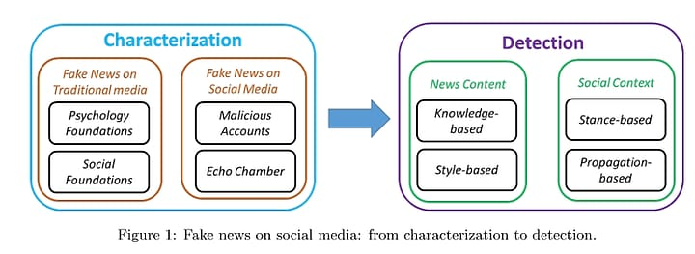
FAKE NEWS CHARACTERIZATION
Fake news definition is made of two parts: authenticity and intent. Authenticity means that fake news content false information that can be verified as such, which means that conspiracy theory is not included in fake news as there are difficult to be proven true or false in most cases. The second part, intent, means that the false information has been written with the goal of misleading the reader

Slide 6
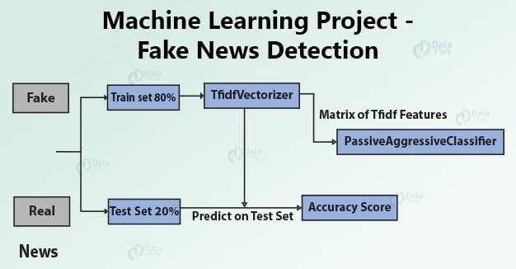
WHAT IS TFIDFVECTORIZER
TF (Term Frequency): The number of times a word appears in a document is its Term Frequency. A higher value means a term appears more often than others, and so, the document is a good match when the term is part of the search terms.
IDF (Inverse Document Frequency): Words that occur many times a document, but also occur many times in many others, may be irrelevant. IDF is a measure of how significant a term is in the entire corpus.

Slide 7

EXAMPLE
Finally a INDIAN student from PONDICHERRY university, named RAMU found a home remedy cure for Covid-19 which is for the very first time accepted by WHO.
He proved that by adding 1 tablespoon of black pepper powder to 2 table spoons of
honey and some ginger juice for consecutive 5 days would suppress the effects of corona.
And eventually go away 100%
Entire world is starting to accept this remedy.
Finally a good news In 2020!!
PLEASE CIRCULATE THIS INFORMATION TO ALL YOUR FAMILY AND FRIENDS.

Slide 8
CONCLUSION
This works focus on textual news content features. Indeed, other features related to social media are difficult to acquire. For example, users information is difficult to obtain on Facebook, as well as post information. In addition, the different datasets that have been presented at style-based model does not provide any other information than textual ones.
Looking at Different approaches to fake news detection it can be seen that the main focus will be made on unsupervised and supervised learning models using textual news content. It should be noted that machine learning models usually comes with a trade-off between precision and recall and thus that a model which is very good at detected fake news might have a high false positive rate as opposite to a model with a low false positive rate which might not be good at detecting them. This cause ethical questions such as automatic censorship that will not be discussed here.

Slide 9
# Import necessary libraries
import pandas as pd
from sklearn.feature_extraction.text import TfidfVectorizer
from sklearn.model_selection import train_test_split
from sklearn.linear_model import PassiveAggressiveClassifier
from sklearn.metrics import accuracy_score
# Load the dataset
# Replace 'fake_news.csv' with the path to your dataset
df = pd.read_csv('fake_news.csv')
# Inspect the dataset
print(df.head())
# Split the dataset into features and labels
X = df['text'] # Features (news articles)
y = df['label'] # Labels (fake or real)
# Split data into training and testing sets
X_train, X_test, y_train, y_test = train_test_split(X, y, test_size=0.2, random_state=42)
# Initialize TfidfVectorizer
tfidf_vectorizer = TfidfVectorizer(stop_words='english', max_df=0.7)
# Fit and transform the training data
tfidf_train = tfidf_vectorizer.fit_transform(X_train)
# Transform the testing data
tfidf_test = tfidf_vectorizer.transform(X_test)
# Initialize PassiveAggressiveClassifier
pac = PassiveAggressiveClassifier(max_iter=50)
# Train the PassiveAggressiveClassifier
pac.fit(tfidf_train, y_train)
# Predict on the testing data
y_pred = pac.predict(tfidf_test)
# Calculate the accuracy
accuracy = accuracy_score(y_test, y_pred)
print(f'Accuracy: {accuracy}')
# Example usage
# Replace 'fake_news_article.txt' with the path to your fake news article
fake_news_article = ["Your fake news article here"]
fake_news_article_tfidf = tfidf_vectorizer.transform(fake_news_article)
prediction = pac.predict(fake_news_article_tfidf)
print(f'Prediction: {prediction}')

Slide 10
X_train, X_test, y_train, y_test = train_test_split(X, y, test_size=0.2, random_state=42)
# Initialize TfidfVectorizer
tfidf_vectorizer = TfidfVectorizer(stop_words='english', max_df=0.7)
# Fit and transform the training data
tfidf_train = tfidf_vectorizer.fit_transform(X_train)
# Transform the testing data
tfidf_test = tfidf_vectorizer.transform(X_test)
# Initialize PassiveAggressiveClassifier
pac = PassiveAggressiveClassifier(max_iter=50)
# Train the PassiveAggressiveClassifier
pac.fit(tfidf_train, y_train)
# Predict on the testing data
y_pred = pac.predict(tfidf_test)
# Calculate the accuracy
accuracy = accuracy_score(y_test, y_pred)
print(f'Accuracy: {accuracy}')

Slide 11
# Example usage
# Replace 'fake_news_article.txt' with the path to your fake news article
fake_news_article = ["Your fake news article here"]
fake_news_article_tfidf = tfidf_vectorizer.transform(fake_news_article)
prediction = pac.predict(fake_news_article_tfidf)
print(f'Prediction: {prediction}')

Slide 12
THANK YOU

